Slide 1

SAP Build Training for Corporate Professionals
DAY-7
www.anubhavtrainings.com

Slide 2


DISCLAIMER
The training content and delivery of this presentation is confidential, and cannot be recorded, or copied and distributed to any third party, without the written consent of Anubhav Trainings

Slide 3
Agenda
Fixing Inbox
Working with inbox for another user
Decision table
Determine agent
Scenario 3
Shopping cart app
Script task
Working with scripts

Slide 4


Scenario
Build Process Automation
BTP
Sales Order
approval
<data>
form
mail
Manager
<data>
Sales Representative
(fedEx office)
Build workzone
My Inbox
S/4HANA

Slide 5
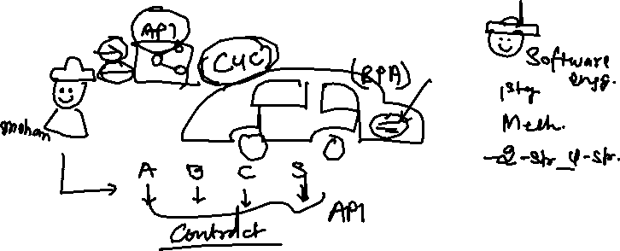
What is API?
API stands for application programming interface, it is a contract between our system and a system which is trying to connect with us.
API gives a contract between caller and called party
That makes integration possible w/o knowing internal functionality of system
Critical role in integration and exchange of data between systems
Serves as single entry point for different business objects (so,po,material)

Slide 6
API HUB
SAP provides a publicly available website. Any developer can go and explore the APIs offered by SAP Solutions e.g. S/4HANA, BTP, Success Factors, Field Glass, Concur etc.
https://api.sap.com
You can request S/4HANA server access – server@anubhavtrainings.com

Slide 7
Requirement
If the sales order amount < 500 EUR – There is no approval required, a direct email will be sent to process initiator that order was auto approved.
Decision Table
When we need to determine multiple conditions, then we can opt for decision table. A control will create branch(s) in the business process but a decision table is a step itself. The control will be used to trigger multiple steps and manage the flow of process at runtime but the decision table is predominantly used to determine the context data at runtime.
e.g. If the sales order type is OR – Standard Order – approval should go to Anubhav – Anubhav.abap@gmail.com
If the order type is IN – inquiry – approval should go to Vaishali – Vaishali@evotrainingsolutions.com
Example of dynamic agent determination like we do in classic abap workflow.

Slide 8
Conditions
If the sales order amount < 500 EUR – There is no approval required, a direct email will be sent to process initiator that order was auto approved.
Decision Table
When we need to determine multiple conditions, then we can opt for decision table. A control will create branch(s) in the business process but a decision table is a step itself. The control will be used to trigger multiple steps and manage the flow of process at runtime but the decision table is predominantly used to determine the context data at runtime.
e.g. If the sales order type is OR – Standard Order – approval should go to Anubhav – Anubhav.abap@gmail.com
If the order type is IN – inquiry – approval should go to Vaishali – Vaishali@evotrainingsolutions.com
Example of dynamic agent determination like we do in classic abap workflow.

Slide 9
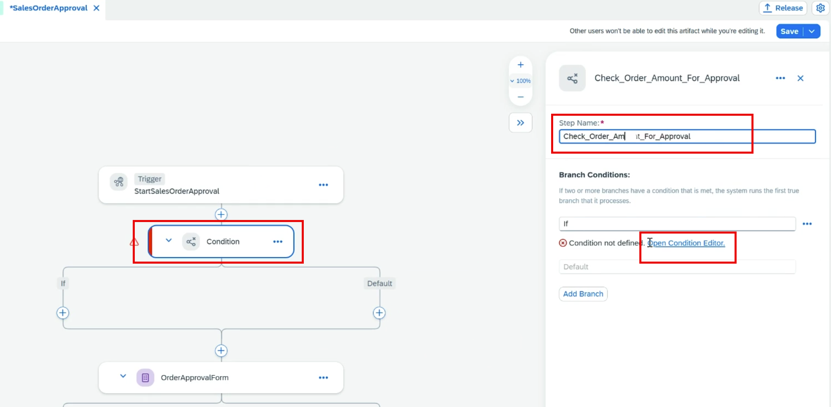
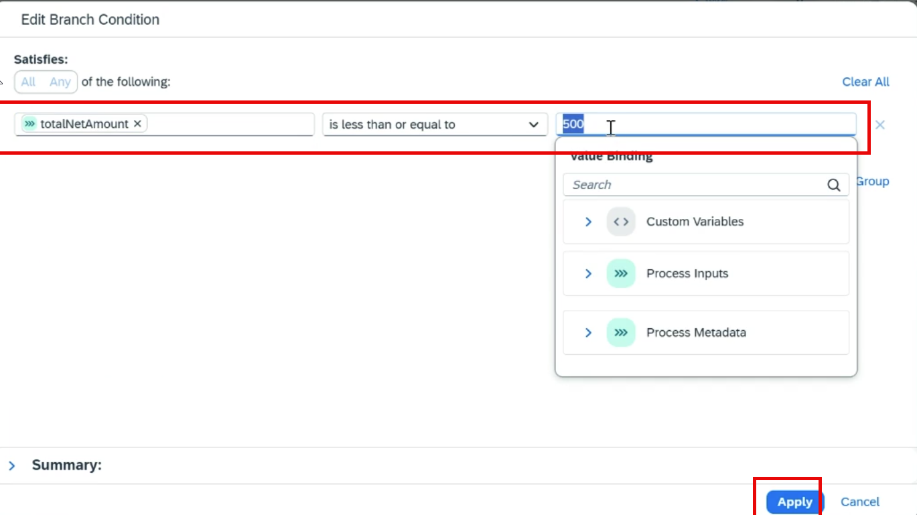
Adding Conditions

Slide 10
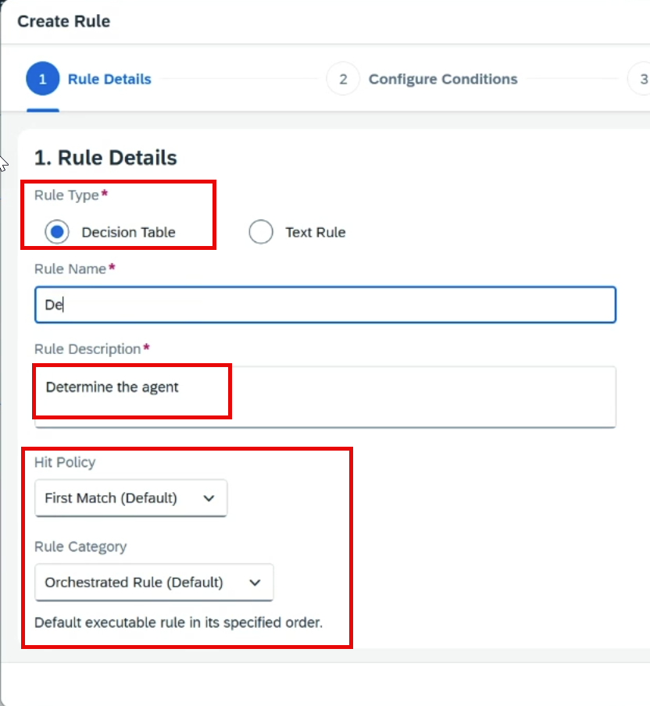
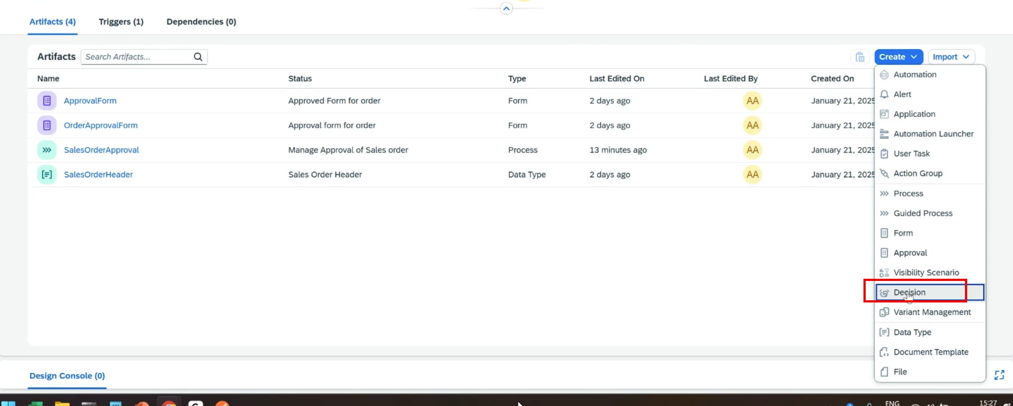
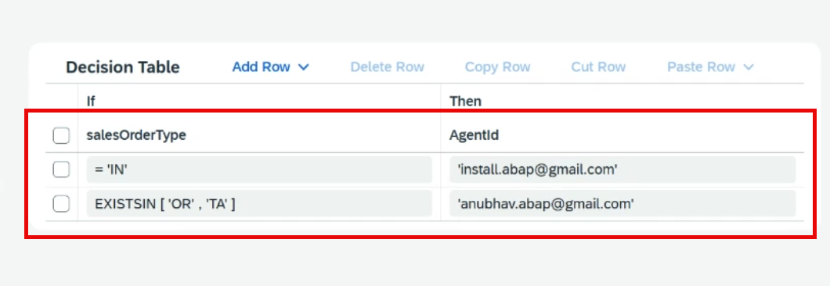
Adding Decision

Slide 11
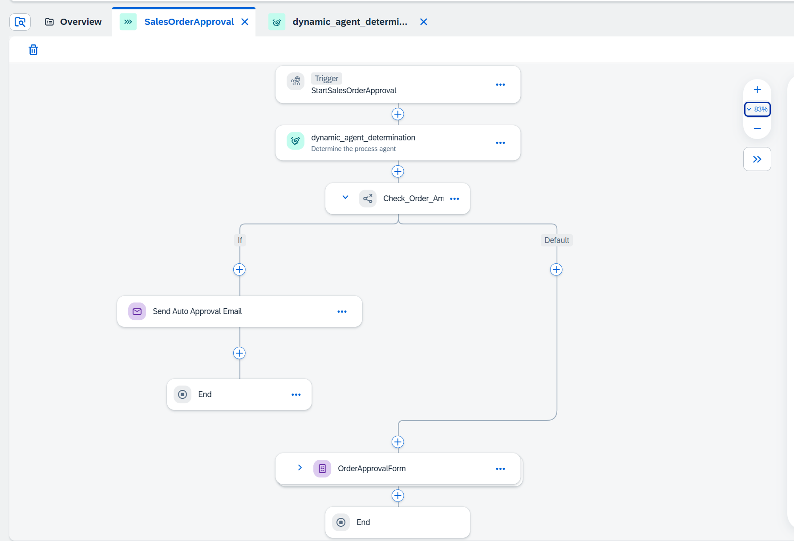

Slide 12

Build Process Scenario 2 – Script Task
Alex is a manager working in one of the top IT Company. He is being approached for every shopping cart request created by employees reporting to him.
His key requirements are:
Design a process to automate the shopping cart for products available at the global API of our organization
As part of the input user can request a discount % to each of the product
The approval should be sent parallelly to VP and manager with a table showing products and total value with discount
Once both the manager and VP approves the requests, an approval email will be sent to requestor
If VP do not take action on shopping cart request for more than 5 minutes, we should proceed w/o approval

Slide 13
The Service
The service information is here:
https://services.odata.org/northwind/northwind.svc/
Property | Value
sap.applicationdevelopment.actions.enabled | true
sap.processautomation.enabled | true
sap.build.usage | odata_gen

Slide 14
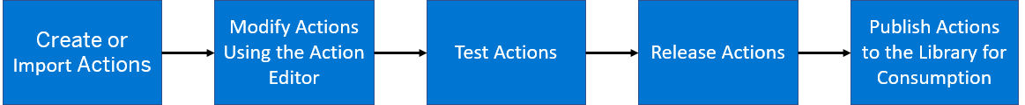
Actions in BPA
You can embed external skills and capabilities into your SAP Build Process Automation projects using the Actions . The Actions project contains specific action artifacts that can be used in managing your business processes.
An Overview of the Actions Project Lifecycle
This image is interactive. Hover over each area for a description. Click highlighted areas for more information.

Slide 15
Steps
Create a destination for the API (service) we want to call
Create an action using the destination and choose a call for getting products
Observe the output and data types if match with result
Go to control tower and destinations and import that destination build BPA
Go to test and check the action by calling API, if needed change data type to fix error
Once testing done, save, release and publish the action
-------
Create a process
Define the input parameter and create api trigger
Add a action connecting to API action for products and system creates a list data type for us
Use the datatype to create variable for holding all data, total, discountedAmount
Map the input and output with action, input process and custom variable
Add script task to calculate total and discount amount
Add parallel branch to execute approval step for manager and VP (binding)
Create deadline monitoring for VP approval form

Slide 16
//get all the data in a variable
var products = $.context.action_get_Alphabetical_list_of_products_1.result.value;
//set default as 0 for total
$.context.custom.totalamount = 0;
///loop on all products data
products.forEach(function (record) {
$.context.custom.totalamount += Number(record.UnitPrice);
});
var discount = $.context.custom.totalamount * ($.context.startEvent.discount) / 100;
$.context.custom.discountedamount = $.context.custom.totalamount - discount;

Slide 17
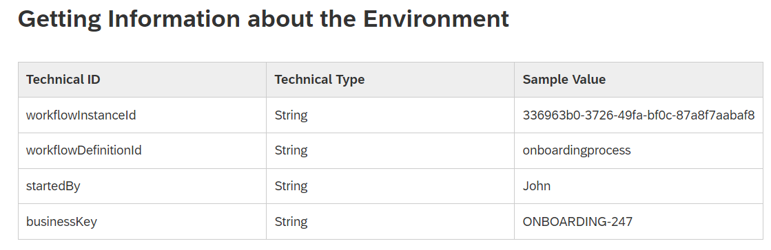
Script task
Script task – we can write code to manipulate the process context, call the process apis at runtime (JS code)
We can also modify the context data during runtime of script task using - $.context.objectname
There are also standard context variable
Cheat sheet workflow expressions
https://help.sap.com/docs/WORKFLOW/e157c391253b4ecd93647bf232d18a83/9f91b1c0fac3414d9cba1015dea381f1.html

Slide 18
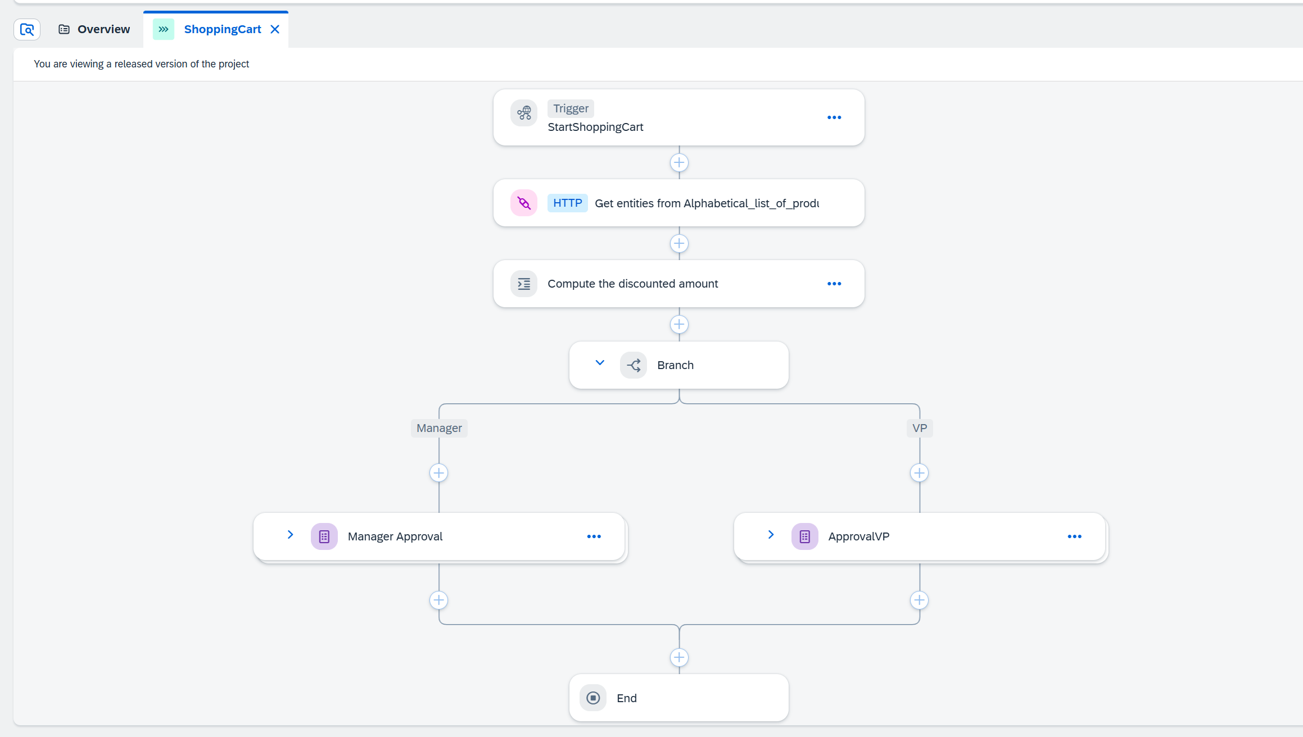

Slide 19

What We Did
Let’s Summarize
www.anubhavtrainings.com

Slide 20
www.anubhavtrainings.com
Thank You
End of Day 6
www.anubhavtrainings.com

Slide 21



We’re committed to empower you to be
#FutureReady
through powerful training solutions.
We build the workforce of the future.
250+
Corporate Clients
30,000+
Learners Trained
25000+
Learners Placed
FREE WEBINARS
Sign up for free webinars with industry experts every fortnight!
Enroll Now!
Contact us today!
https://anubhavtrainings.com

